Slide 1
The Emerging Landscape of Trade: Trump's Reciprocal Tariff and Its Implications for Bangladesh
Md. Deen Islam, PhD
Associate Professor, Economics, University of Dhaka
Research Director, Research and Policy Integration for Development
April 20, 2025
Dacca Institute of Research & Analytics (DAIRA)

Slide 2
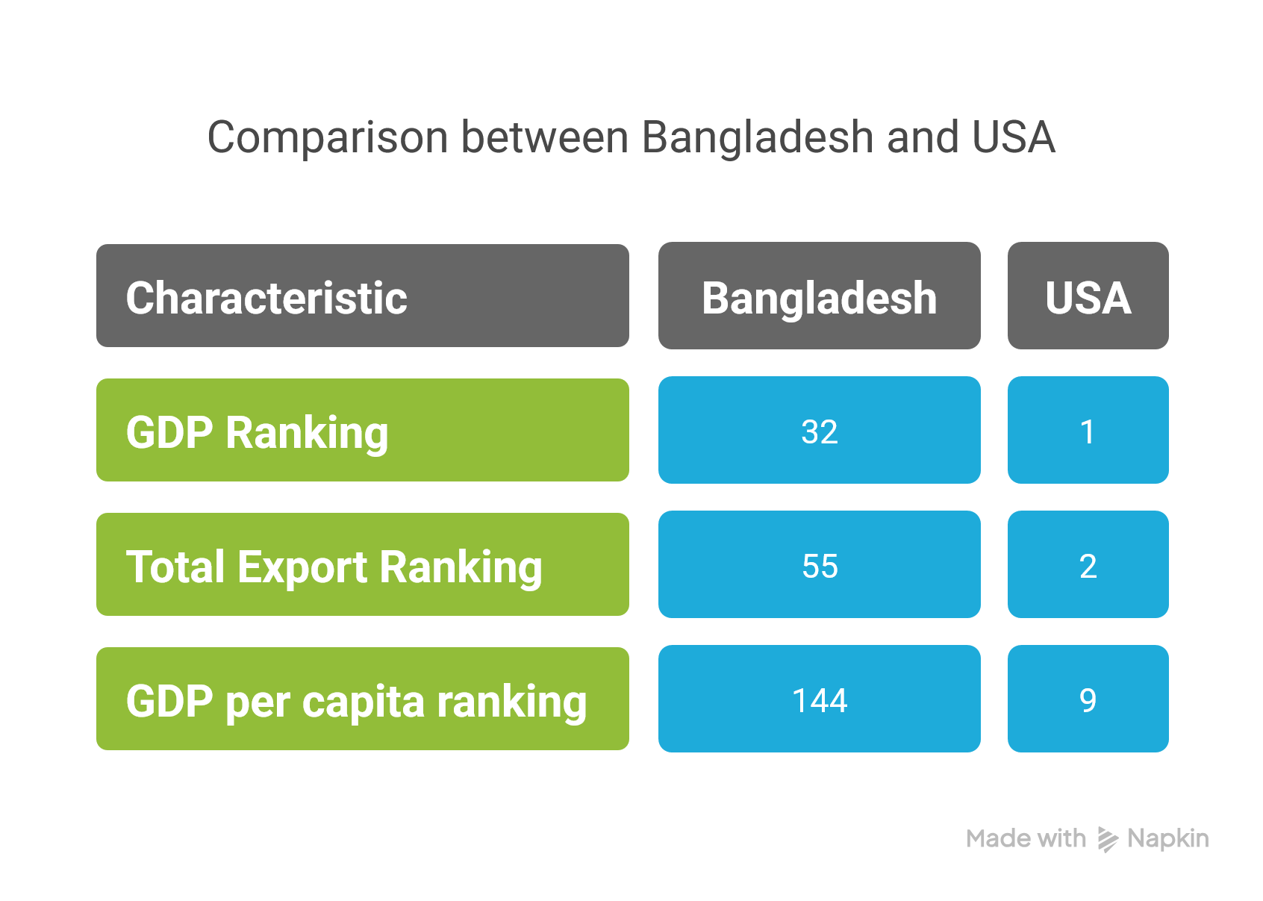
Source: Based on OEC data

Slide 3
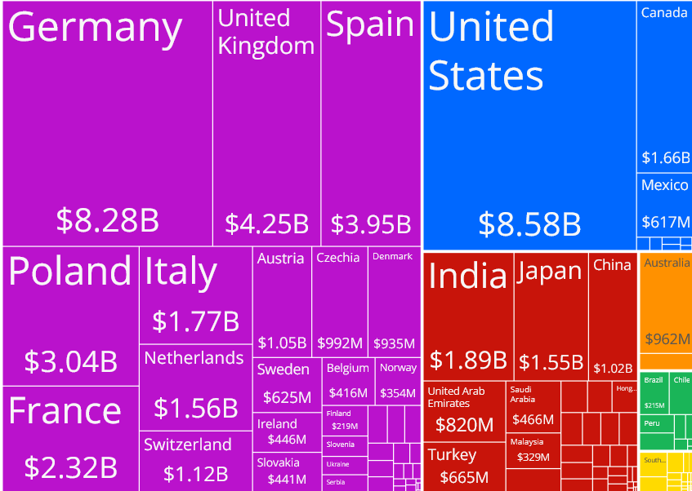
The United States is Bangladesh's single largest export market
Source: OEC, 2023.

Slide 4
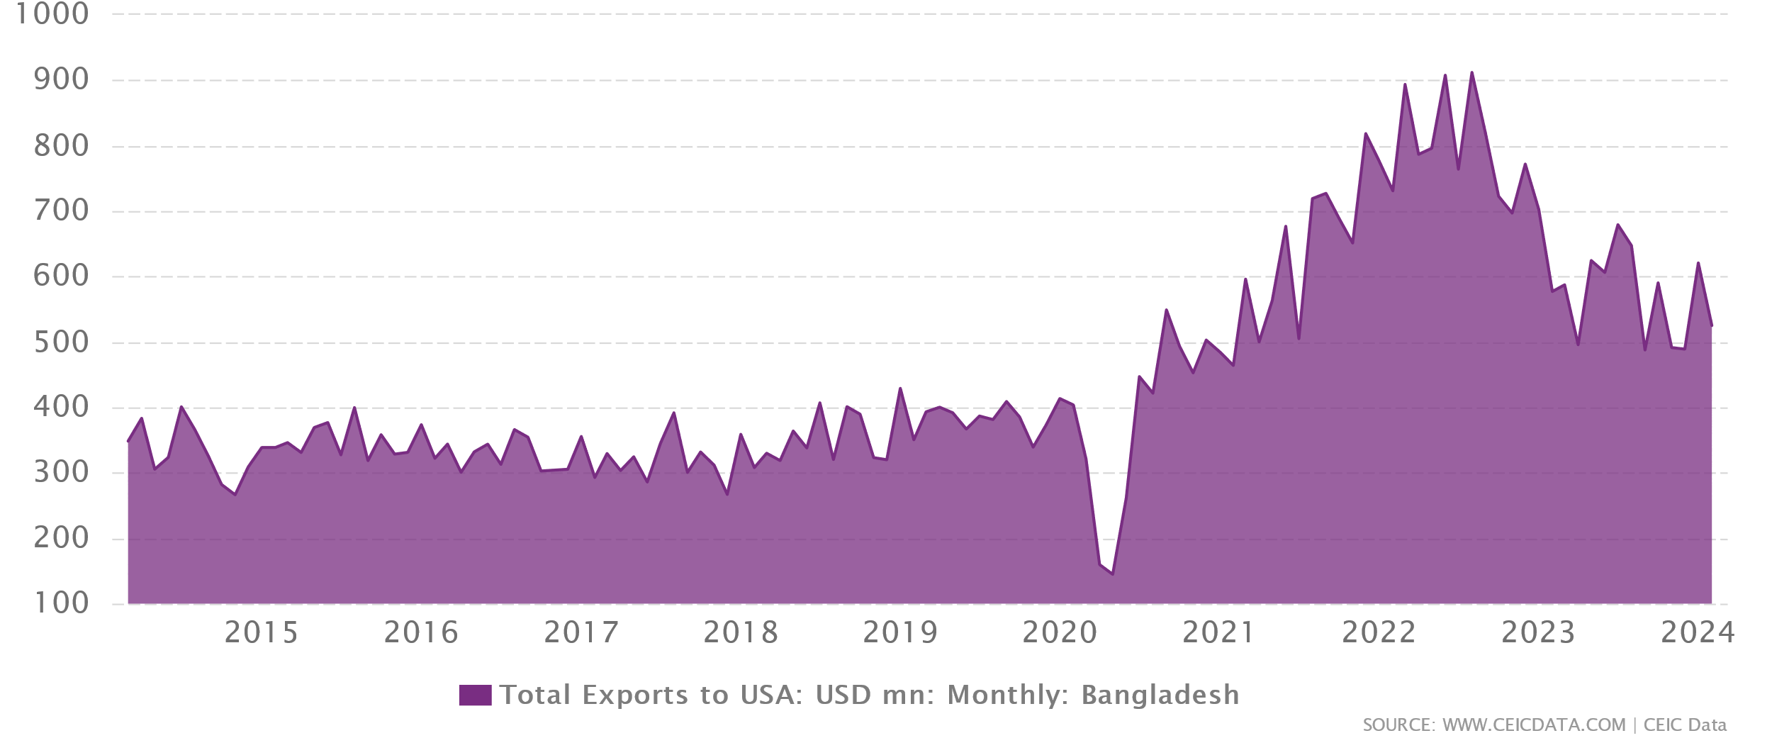
Bangladesh’s exports to the US have achieved a new level after the COVID-19 pandemic

Slide 5
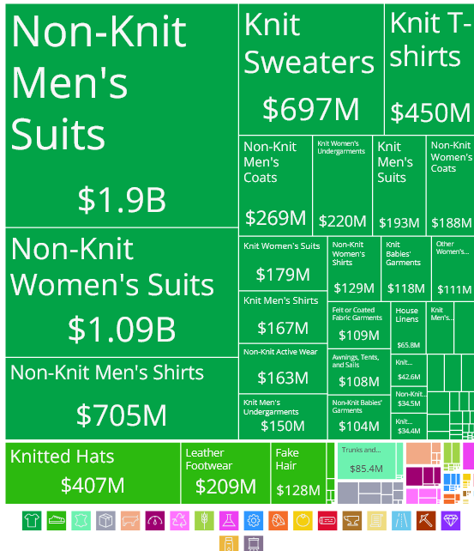
Exports from Bangladesh to the United States in 2023

Slide 6
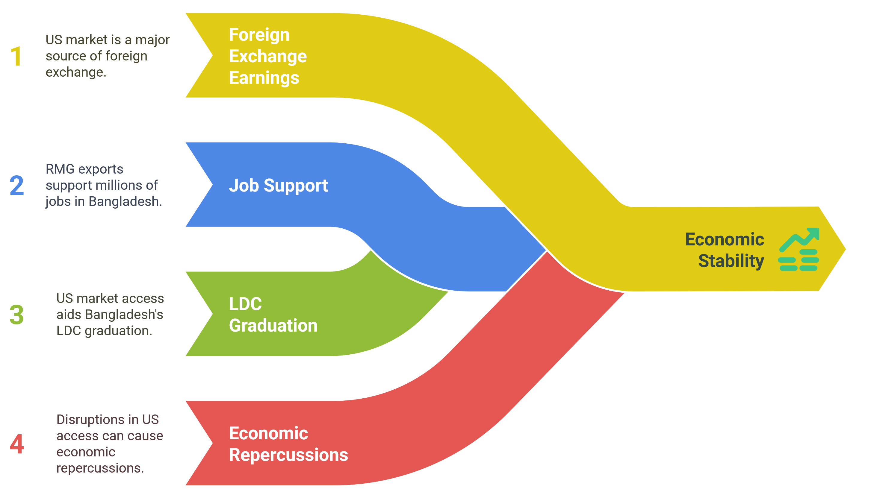
The US Market is crucial for Macroeconomic Stability in Bangladesh

Slide 7
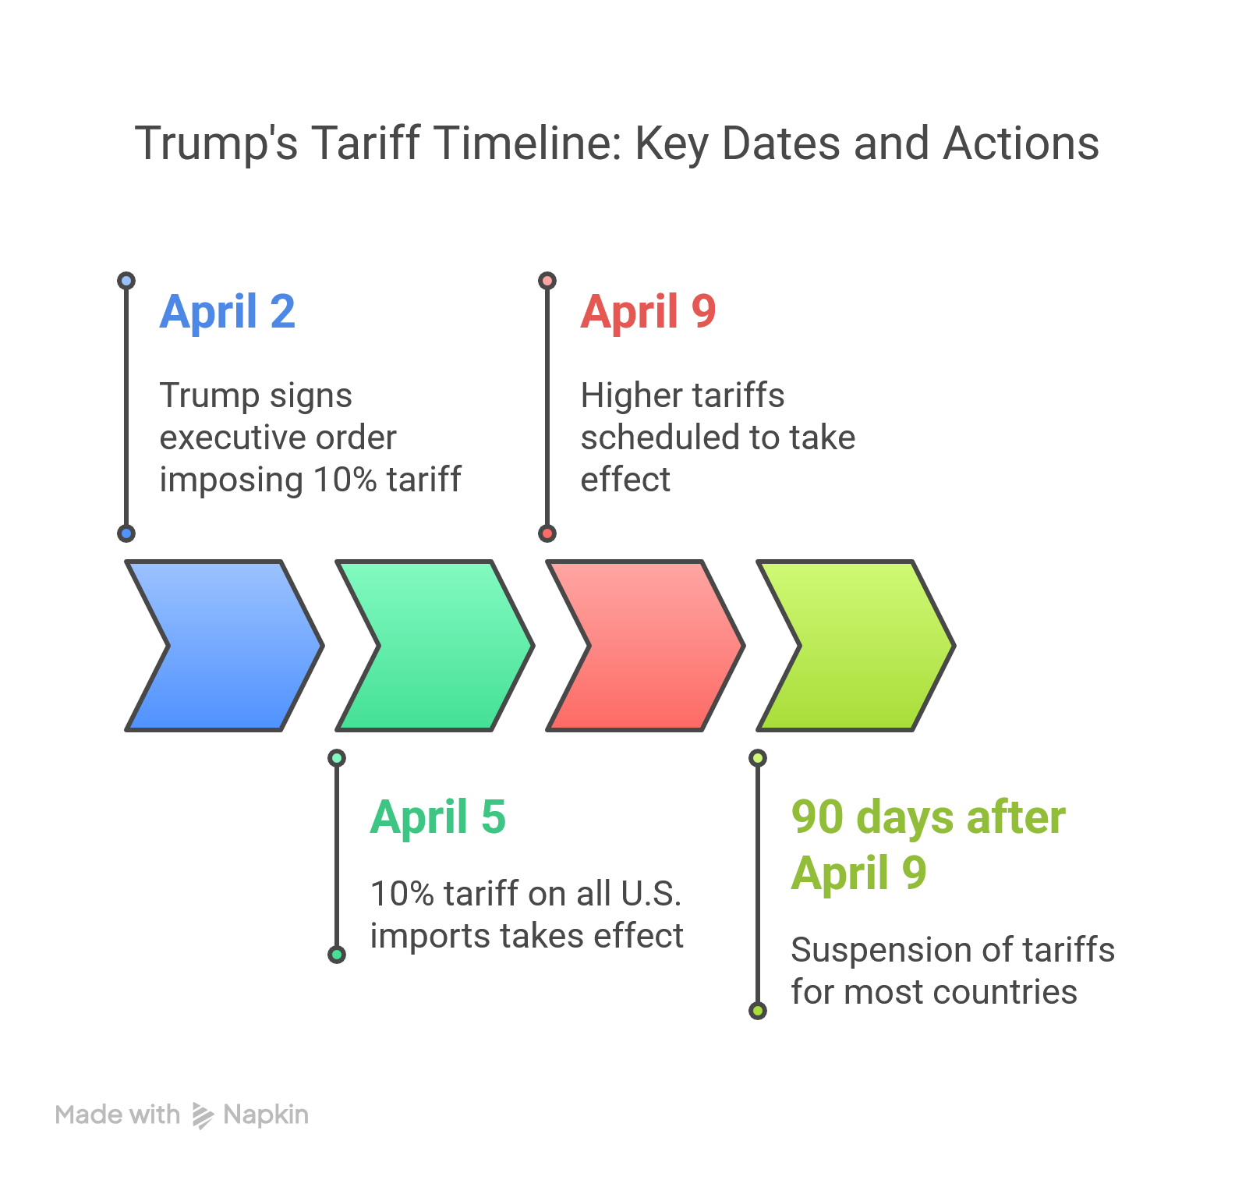
Trump’s so-called “Reciprocal Tariff” is a blow to the rule-based trading system under the WTO

Slide 8

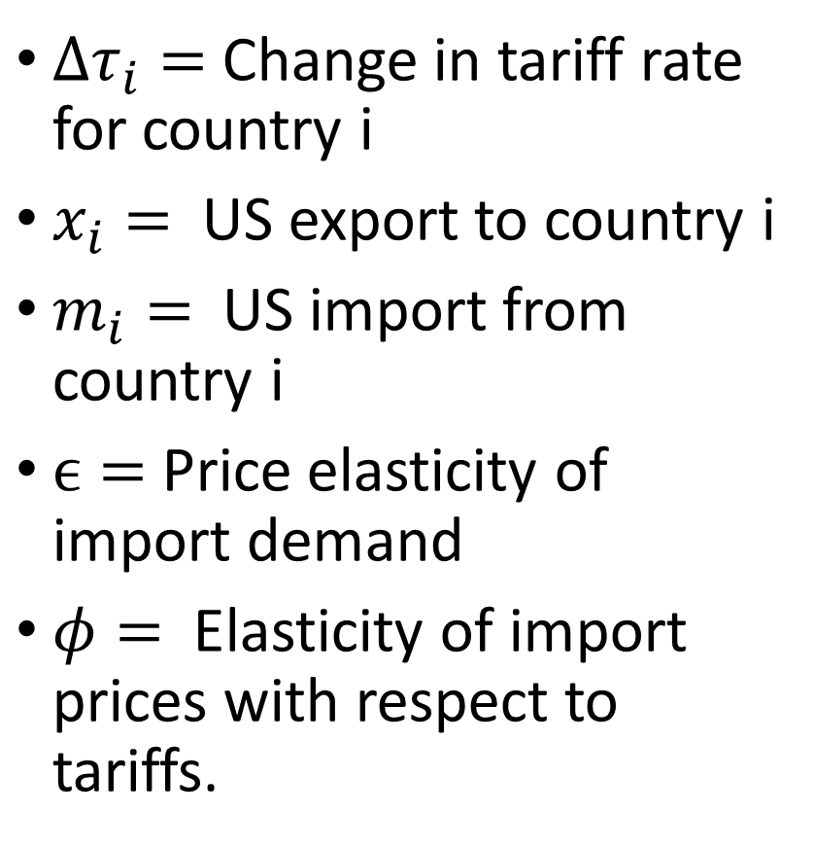
The “Reciprocal Tariff” formula is ad hoc in nature
${Δτ}_{i}=$ Change in tariff rate for country i
$x_{i}=$US export to country i
$m_{i}=$ US import from country i
$ϵ=$Price elasticity of import demand
$φ=$ Elasticity of import prices with respect to tariffs.

Slide 9

The parameter values used are not supported by empirical evidence
The Trump administration set ε = −4 and φ = 0.25,
then multiplied them for ε × φ = −1, which resulted in no change except to make the result positive when ε × φ was multiplied
Empirically, φ is found to be close to 1 not 0.25 (0.945, according to AEI).
Using the correct value of φ would have resulted in one-fourth of the proposed tariffs.
US Reciprocal Tariffs have nothing to do with other countries’ tariffs on US exports; rather, it is based on the trade deficit with the US.

Slide 10
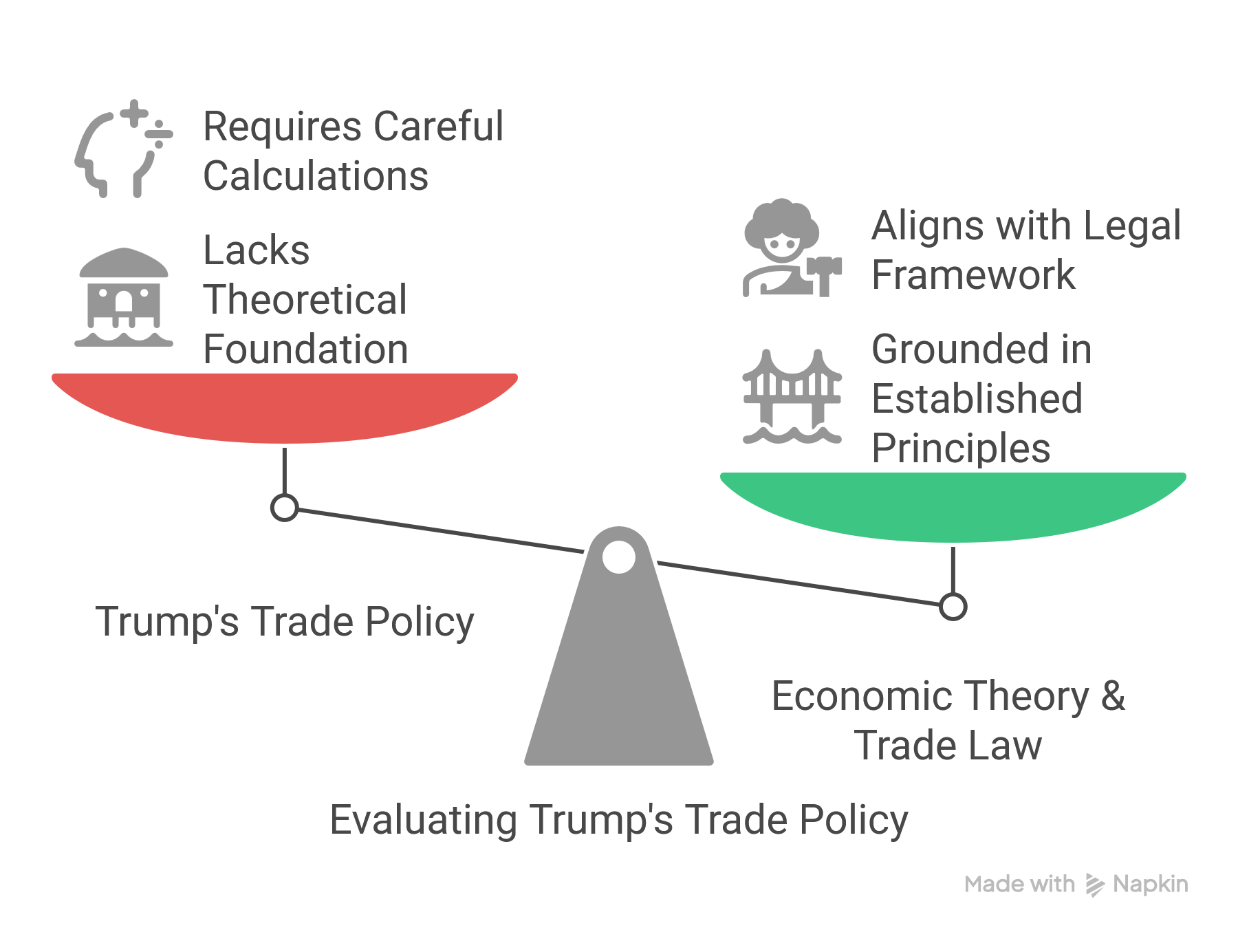
The formula the administration relied on has no foundation in either economic theory or trade law

Slide 11
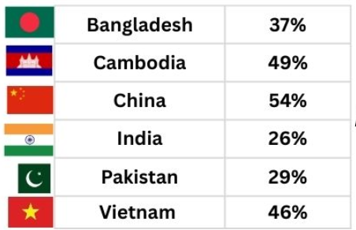
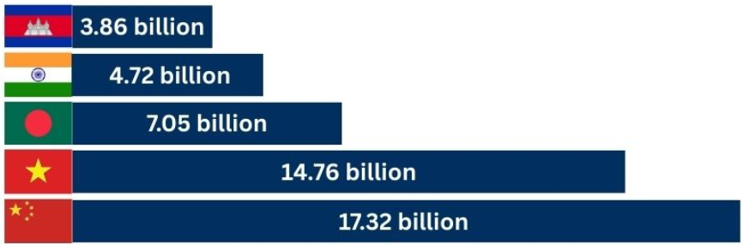
Reciprocal tariff rates for Bangladesh and its competitors in the US market

Slide 12
US so-called “Reciprocal Tariffs” can induce macroeconomic instability in Bangladesh
Bangladesh’s garment exporters are at risk. US shoppers may buy fewer clothes as it will become expensive, shrinking the overall size of the market.
Higher tariffs on competitors like China and Vietnam can help gain some additional market share in the US, but Bangladesh could face greater competition from these competitors in the EU markets.
Bangladesh may also face currency pressure, straining reserves and fiscal space.
Women and informal workers in RMG are most vulnerable.

Slide 13
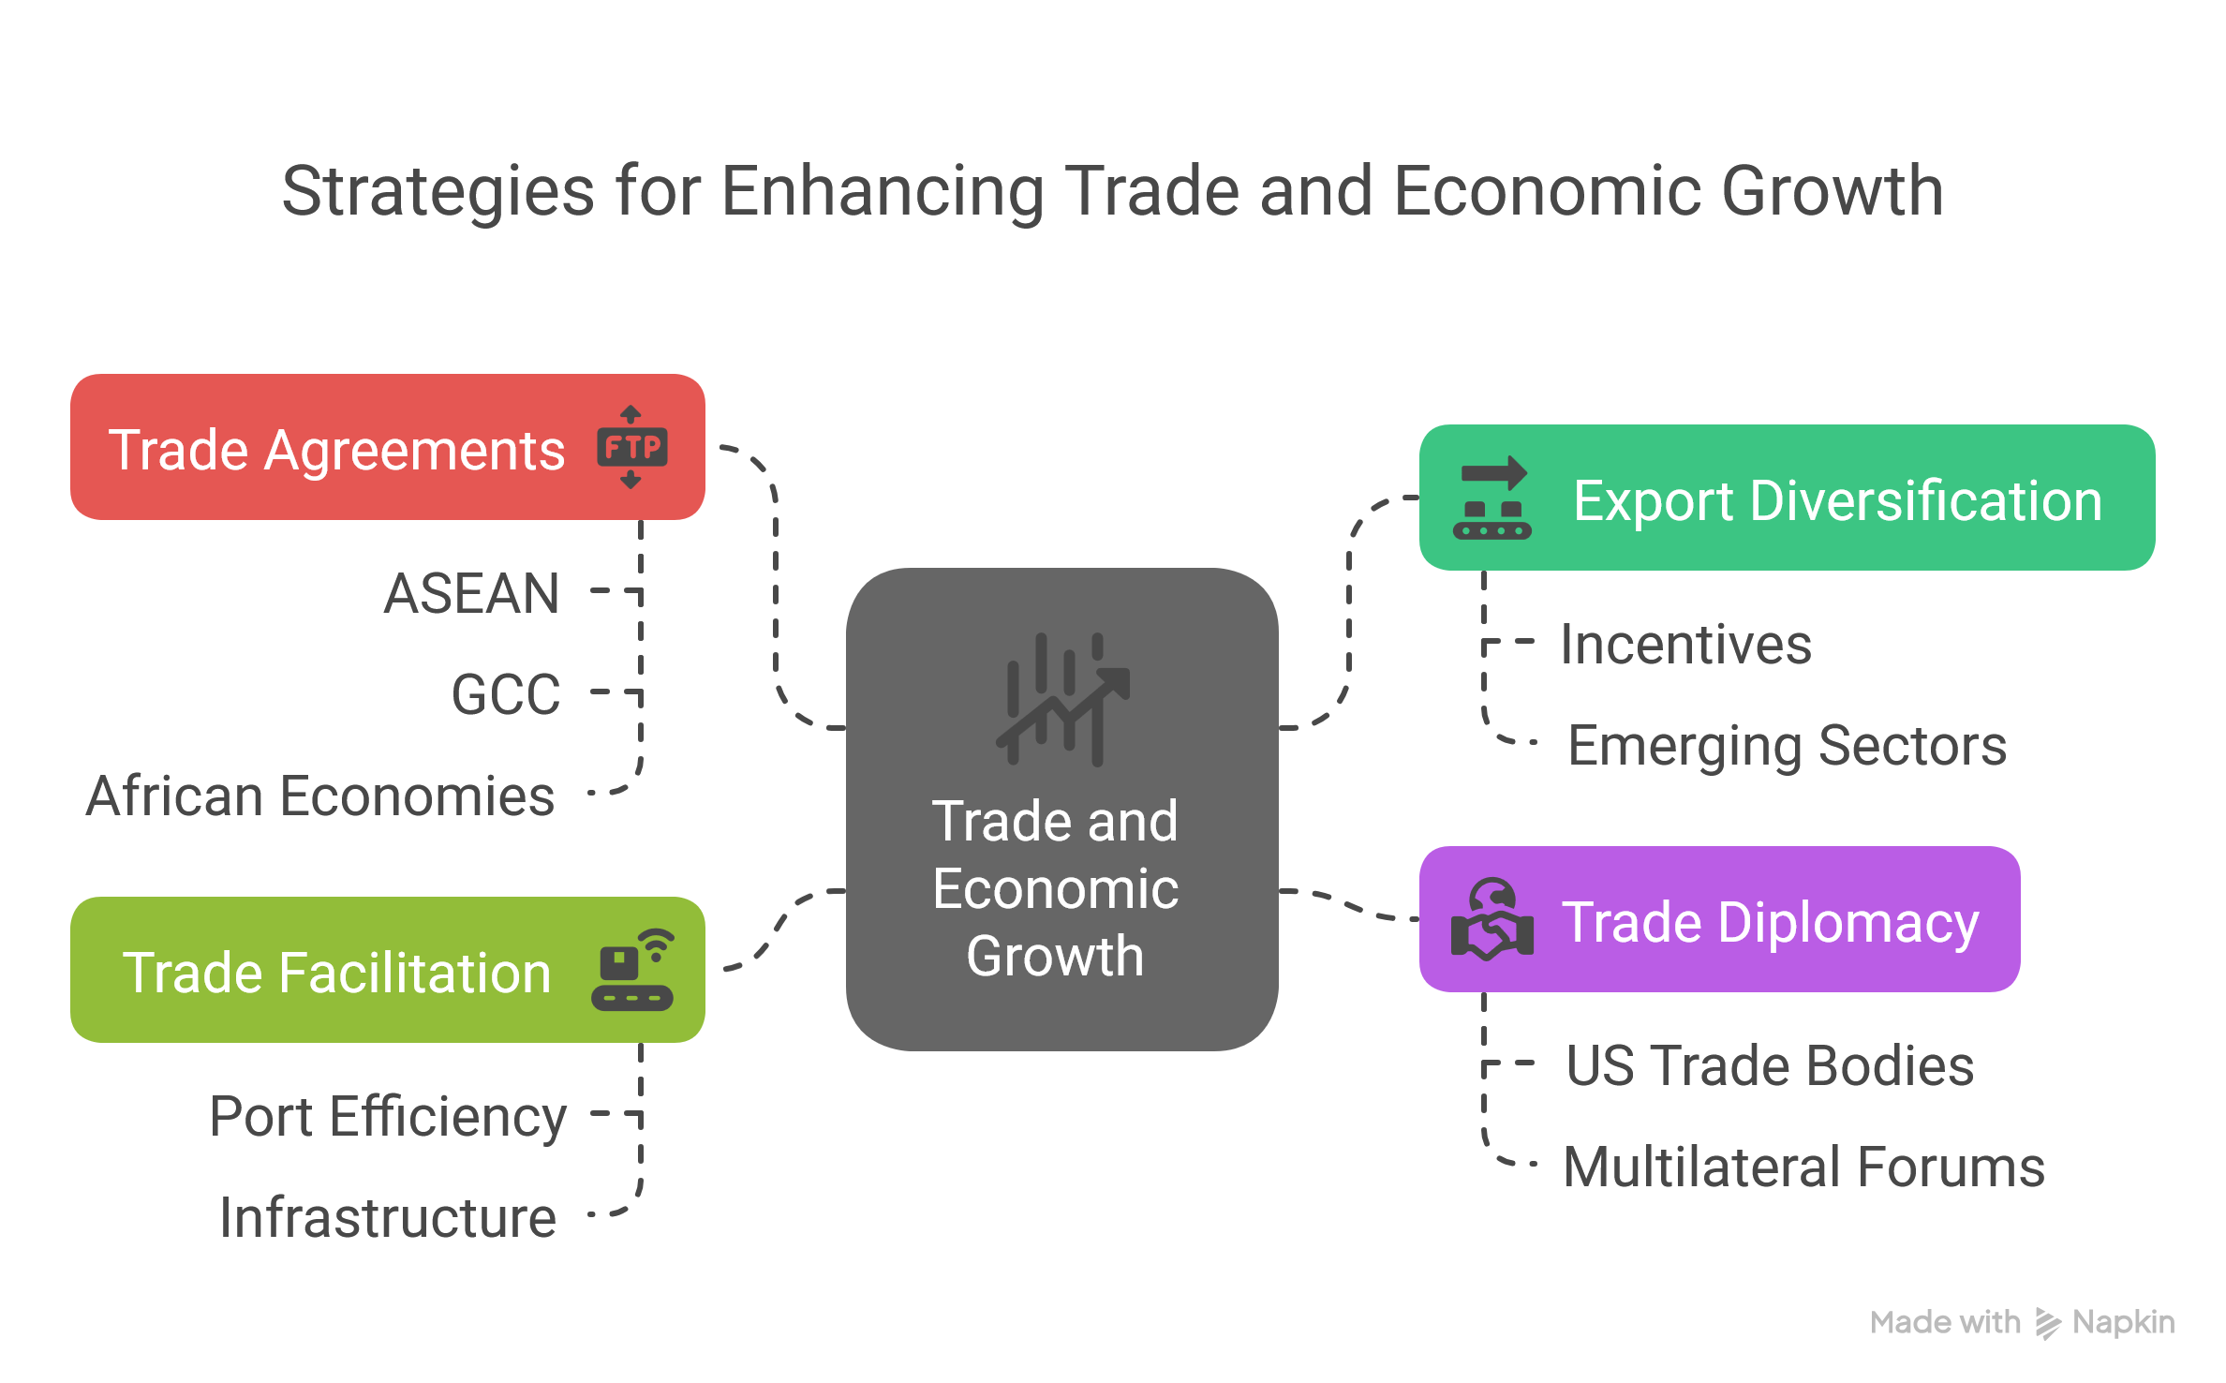
What are the policy tools available for Bangladesh to tackle this situation

Slide 14
Final thought
The US reciprocal tariff strategy presents both risks and opportunities.
Bangladesh must adopt a forward-looking, diversified export strategy.
Smart diplomacy, structural reform, and private sector innovation are key.
Being prepared will determine whether Bangladesh is sidelined or elevated in the new trade regime.

Slide 15
Thank You

